Slide 1
Curacao Stage One Utility-Scale Solar PV Assessment
Presentation to Aqualectra
Michael Ginsberg, Mastering Green
January 2017

Slide 2
About Us: Mastering Green
Mastering Green
Solar PV design and installation
Sustainability reporting
Green buildings
Michael Ginsberg, CEO
10+ years consulting for US and International Governments on solar PV, energy management and policy, green buildings, and facilities maintenance
Doctoral Candidate, Solar PV Grid Integration, School of Engineering and Applied Science, Columbia University
MS Sustainability Management, Columbia University
LEED AP O+M
NABCEP PV Associate
Certified Energy Manager

Slide 3
Curacao’s Energy Mix
2008 Demand: 968,000 MWh
70 percent fossil fuels
30 percent wind energy
Four wind farms

Slide 4
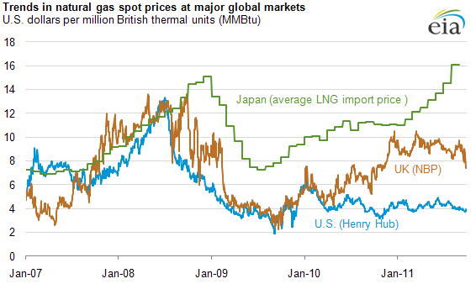
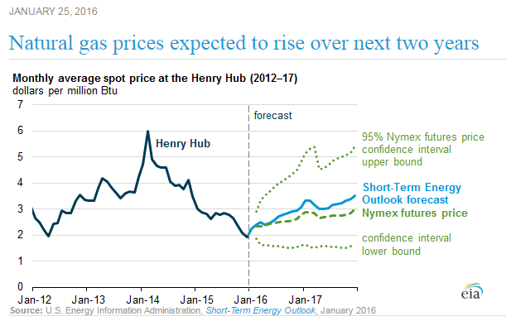
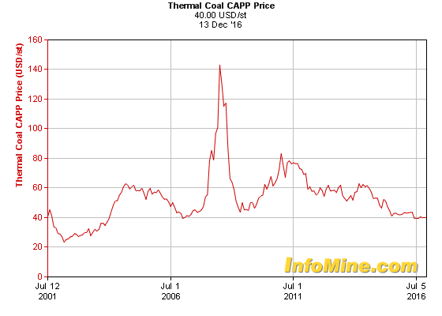
Unpredictable Coal and Natural Gas Costs
Imported
Variable
Rising long term
...more customization options
Notes:
Despite a recent OPEC-driven downturn in the oil and gas industry, fossil fuel costs have been steadily rising.

Slide 5
Public Health & International Image
Notes:
PDVSA Isla refinery pollution

Slide 6
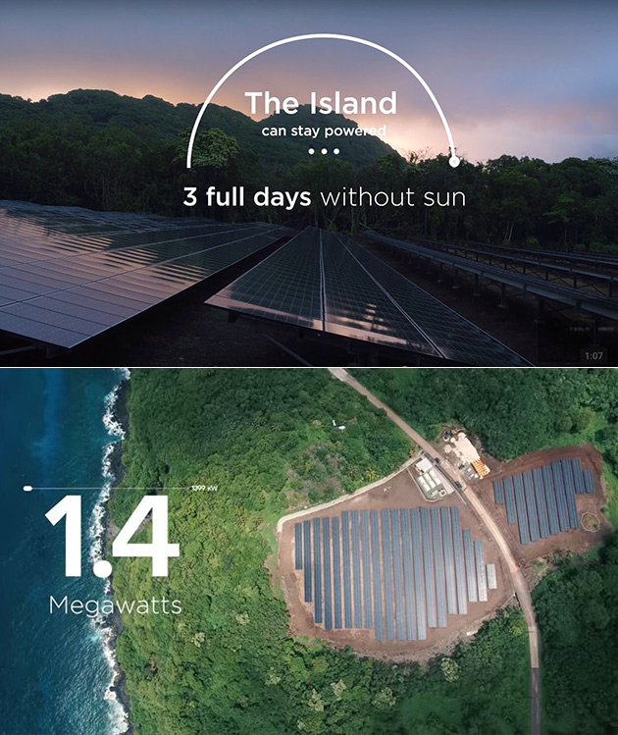
Energy Independence through Renewable Energy
Ta’u, American Samoa
Notes:
Ta’u – 100% renewable with Tesla
Aruba
10 Island challenge – Richard Branson

Slide 7
But What If I Told You…
Solar PV could provide at least 30% of Curacao’s energy mix
At an upfront cost of $256,500,000 USD for 171 MW of installed PV capacity
Annual income of $81,312,000 USD
3.2 year payback period
32% rate of return
Lifetime value of $1,776,300,000 USD
Notes:
Analysis assumes vertical integration of investor-owned utility. PV plant will be owned and operated by Aqualectra. Analysis also assumes 100% utilization of power produced from PV system.

Slide 8
Curacao’s Solar Resource
2,000 – 2,250 kWh/m² of annual solar radiation
5.5 – 6.2 peak sun hours/day

Slide 9
Site Selection
Irradiance
Terrain
Population Density
Land Ownership Status

Slide 10
Irradiance
> 2,100 kWh/m²/year
>/=5.5 Peak Sun Hours/day
Notes:
To achieve the 5.5 daily peak sun hours, optimal sites include locations with > 2,100 kWh/m²/year, as shown in the blue circles.

Slide 11
Population Density
< five inhabitants/km²

Slide 12
Terrain
Even terrain
1
2

Slide 13
Land Ownership Status
Site 1
Consult with Santa Catharina and Government of Curacao
Site 2
Privately owned

Slide 14
Site 1: Northeast
Location: Santa Catharina/Labadera
Total area: 1.22 km²
Modules: 488,572 (350 watt high efficiency)
Capacity: 171 MW
Notes:
Consult with Santa Catharina and determine ownership.

Slide 15
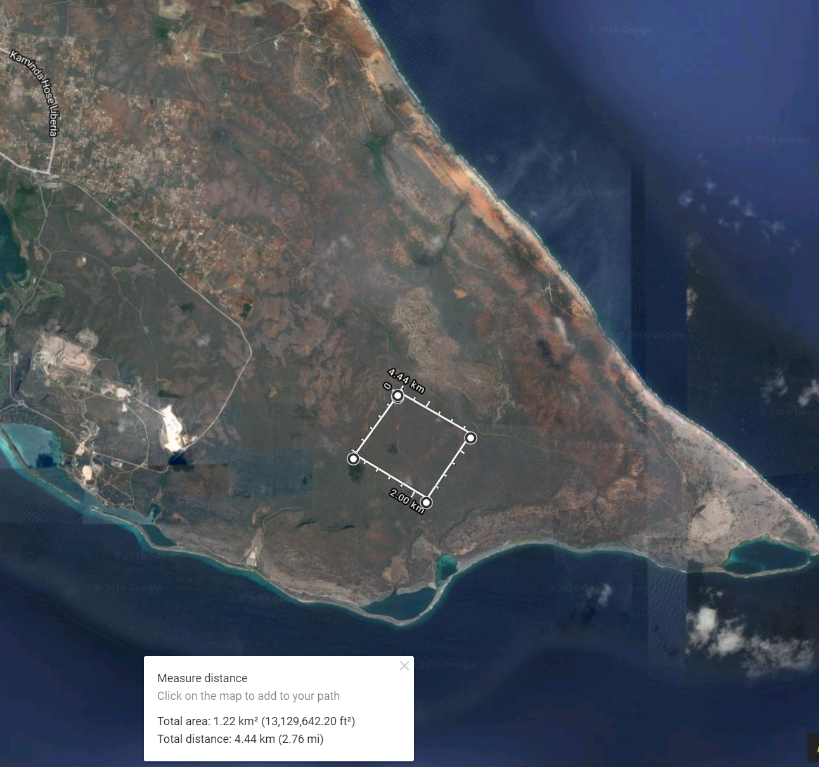
Site 2: Eastern End
Location: Eastern End – Private Property
Total area: 1.22 km²
Modules: 488,572 (350 watt high efficiency)
Capacity: 171 MW
Notes:
Contact private owner.

Slide 16
Next Steps
Investigation of property ownership for selected areas.
Physical inspection of sites to confirm optimal selection, including shading. Verify through NREL’s System Advisor Model (SAM).
Comprehensive estimate for solar PV system cost, including grid upgrades required.
Consideration of upgrades to grid needed to accommodate solar PV system: battery storage (i.e. what occurs when production exceeds demand), transmission infrastructure, voltage regulation, etc.
Comprehensive financial model to incorporate discount rates. Verify through NREL’s System Advisor Model (SAM).
Consideration of PPA (power purchase agreement) and BOOT (build, own, operate, transfer) mechanisms.

Slide 17
Questions?
Let’s begin! Lagá nos cuminsá!
Contact:
Ginsberg Integrated Sustainability
www.mastering-green.com
Michael Ginsberg, CEO
mginsberg@mastering-green.com
Mobile: +5999-526-6453
U.S.: 203-967-4501

Slide 18
References
"Aqualectra tariffs." Aqualectra. December 1, 2016. http://www.aqualectra.com/files/Tarieven_2016/Dec_Valid_Tariffs_as_per_december_01_2016.pdf.
"Can we live with wind energy?" Aqualectra. Accessed December 10, 2016. http://www.aqualectra.com/files/PDF/fly_energia_bientu_eng.pdf.
"Solargis." SOLAR GIS MAPS. Accessed December 10, 2016. http://solargis.info/imaps/#c=12.145325,-68.85915&z=11. Satellite-derived irradiance database.
"The World Factbook: CURACAO." Central Intelligence Agency. Accessed December 10, 2016.
https://www.cia.gov/library/publications/the-world-factbook/geos/cc.html.

